Slide 1
Important
1. There will be three class tests.
2. Two class tests will be considered for final evaluation.
3. Group Assignments and quiz will also be a part of continuous assessment.

Slide 2
Attention!!
All participants are requested to bring the reference book and calculator in the class.

Slide 3
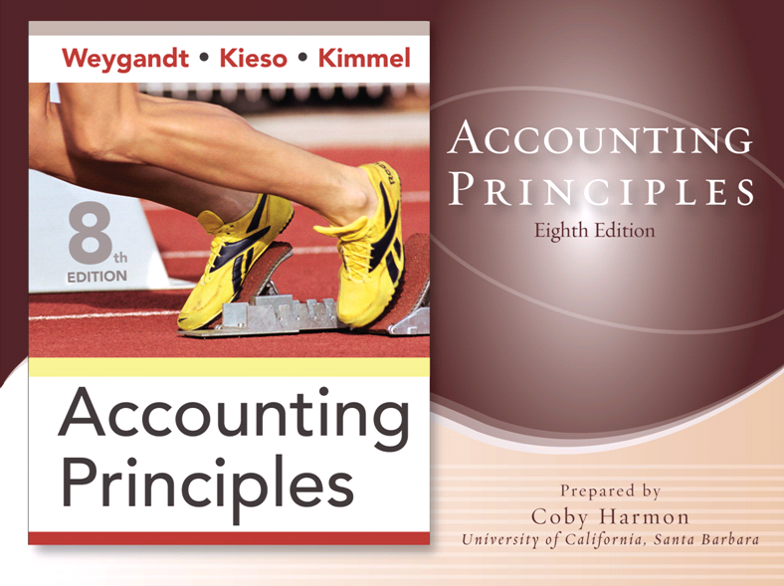

Slide 4
CHAPTER 1
ACCOUNTING IN ACTION
Accounting Principles, Eighth Edition

Slide 5

Accounting in Action
What is Accounting?
The Building Blocks of Accounting
The Basic Accounting Equation
Using the Basic Accounting Equation
Financial Statements
Three activities
Who uses accounting data
Ethics in financial reporting
Generally accepted accounting principles
Assumptions
Assets
Liabilities
Owner’s equity
Transaction analysis
Summary of transactions
Income statement
Owner’s equity statement
Balance sheet
Statement of cash flows
Notes:
Service Cost - Actuaries compute service cost as the present value of the new benefits earned by employees during the year. Future salary levels considered in calculation.
Interest on Liability - Interest accrues each year on the PBO just as it does on any discounted debt.
Actual Return on Plan Assets - Increase in pension funds from interest, dividends, and realized and unrealized changes in the fair market value of the plan assets.
Amortization of Unrecognized Prior Service Cost - The cost of providing retroactive benefits is allocated to pension expense in the future, specifically to the remaining service-years of the affected employees.
Gain or Loss - Volatility in pension expense can be caused by sudden and large changes in the market value of plan assets and by changes in the projected benefit obligation. Two items comprise the gain or loss:
difference between the actual return and the expected return on plan assets and,
amortization of the unrecognized net gain or loss from previous periods

Slide 6
What is Accounting?
The purpose of accounting is to:
identify, record, and communicate the economic events of an
organization to
interested users.
LO 1 Explain what accounting is.

Slide 7
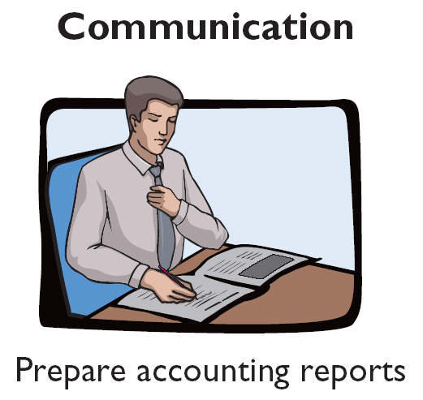
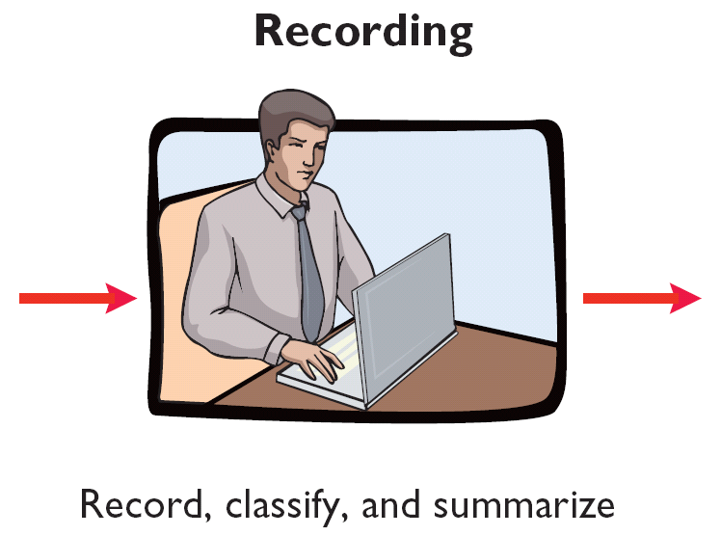
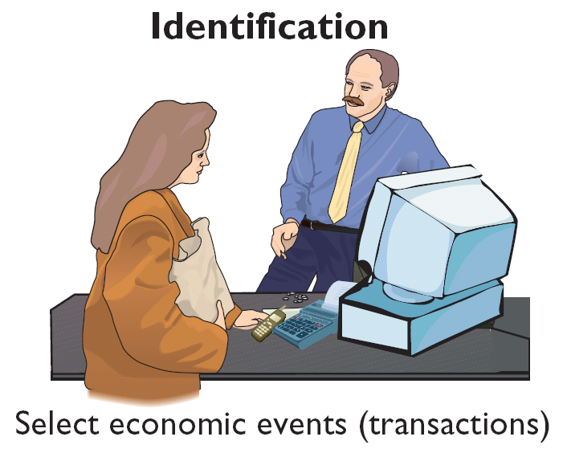

What is Accounting?
Three Activities
Illustration 1-1
Accounting process
The accounting process includes
the bookkeeping function.
LO 1 Explain what accounting is.

Slide 8
Who Uses Accounting Data?
Internal Users
Management
IRS
Human Resources
Investors
There are two broad groups of users of financial information: internal users and external users.
Labor Unions
Finance
Creditors
Marketing
SEC
Customers
External Users
LO 2 Identify the users and uses of accounting.

Slide 9
Who Uses Accounting Data?
Common Questions Asked
User
1. Can we afford to give our employees a pay raise?
Human Resources
2. Did the company earn a satisfactory income?
Investors
3. Do we need to borrow in the near future?
Management
4. Is cash sufficient to pay dividends to the stockholders?
Finance
5. What price for our product will maximize net income?
Marketing
6. Will the company be able to pay its short-term debts?
Creditors
LO 2 Identify the users and uses of accounting.

Slide 10
Who Uses Accounting Data?
Discussion Question
Q1. “Accounting is ingrained in our society and it is vital to our economic system.” Do you agree? Explain.
LO 3 Understand why ethics is a fundamental business concept.
Notes:
Question 1 (textbook) Yes, this is correct. Virtually every organization and person in our society uses accounting information. Businesses, investors, creditors, government agencies, and not-for-profit organizations must use accounting information to operate effectively.

Slide 11
The Building Blocks of Accounting
Ethics In Financial Reporting
Standards of conduct by which one’s actions are judged as right or wrong, honest or dishonest, fair or not fair, are Ethics.
LO 3 Understand why ethics is a fundamental business concept.

Slide 12
Ethics
Review Question
Ethics are the standards of conduct by which one's actions are judged as:
  right or wrong.
  honest or dishonest.
  fair or not fair.
  all of these options.
LO 3 Understand why ethics is a fundamental business concept.

Slide 13
Ethics
Review Question
Ethics are the standards of conduct by which one's actions are judged as:
  right or wrong.
  honest or dishonest.
  fair or not fair.
  all of these options.
LO 3 Understand why ethics is a fundamental business concept.

Slide 14

The Building Blocks of Accounting
Financial Statements
Balance Sheet
Income Statement
Statement of Owner’s Equity
Statement of Cash Flows
Note Disclosure
Various users need financial information
The accounting profession has attempted to develop a set of standards that are generally accepted and universally practiced.
Generally Accepted Accounting Principles (GAAP)
LO 4 Explain generally accepted accounting principles and the cost principle.

Slide 15



The Building Blocks of Accounting
Organizations Involved in Standard Setting:
  Securities and Exchange Commission (SEC)
  Financial Accounting Standards Board (FASB)
  International Accounting Standards Board (IASB)
http://www.sec.gov/
http://www.fasb.org/
http://www.iasb.org/
LO 4 Explain generally accepted accounting principles and the cost principle.

Slide 16

The Building Blocks of Accounting
Cost Principle (Historical) – dictates that companies record assets at their cost.
Issues:
  Reported at cost when purchased and also over the time the asset is held.
  Cost easily verified, whereas market value is often subjective.
  Fair value information may be more useful.
LO 4 Explain generally accepted accounting principles and the cost principle.

Slide 17
Assumptions
Monetary Unit Assumption – include in the accounting records only transaction data that can be expressed in terms of money.
Economic Entity Assumption – requires that activities of the entity be kept separate and distinct from the activities of its owner and all other economic entities.
  Proprietorship.
  Partnership.
  Corporation.
Forms of Business Ownership
LO 5 Explain the monetary unit assumption and the economic entity assumption.

Slide 18
Forms of Business Ownership
Proprietorship
Partnership
Corporation
Generally owned by one person.
Often small service-type businesses
Owner receives any profits, suffers any losses, and is personally liable for all debts.
Owned by two or more persons.
Often retail and service-type businesses
Generally unlimited personal liability
Partnership agreement
Ownership divided into shares of stock
Separate legal entity organized under state corporation law
Limited liability
LO 5 Explain the monetary unit assumption and the economic entity assumption.
Notes:
Service Cost - Actuaries compute service cost as the present value of the new benefits earned by employees during the year. Future salary levels considered in calculation.
Interest on Liability - Interest accrues each year on the PBO just as it does on any discounted debt.
Actual Return on Plan Assets - Increase in pension funds from interest, dividends, and realized and unrealized changes in the fair market value of the plan assets.
Amortization of Unrecognized Prior Service Cost - The cost of providing retroactive benefits is allocated to pension expense in the future, specifically to the remaining service-years of the affected employees.
Gain or Loss - Volatility in pension expense can be caused by sudden and large changes in the market value of plan assets and by changes in the projected benefit obligation. Two items comprise the gain or loss:
difference between the actual return and the expected return on plan assets and,
amortization of the unrecognized net gain or loss from previous periods

Slide 19
Assumptions
Review Question
Combining the activities of Kellogg and General Mills would violate the
  cost principle.
  economic entity assumption.
  monetary unit assumption.
  ethics principle.
LO 5 Explain the monetary unit assumption and the economic entity assumption.

Slide 20
Assumptions
Review Question
Combining the activities of Kellogg and General Mills would violate the
  cost principle.
  economic entity assumption.
  monetary unit assumption.
  ethics principle.
LO 5 Explain the monetary unit assumption and the economic entity assumption.

Slide 21
Forms of Business Ownership
Review Question
A business organized as a separate legal entity under state law having ownership divided into shares of stock is a
  proprietorship.
  partnership.
  corporation.
  sole proprietorship.
LO 5 Explain the monetary unit assumption and the economic entity assumption.

Slide 22
Forms of Business Ownership
Review Question
A business organized as a separate legal entity under state law having ownership divided into shares of stock is a
  proprietorship.
  partnership.
  corporation.
  sole proprietorship.
LO 5 Explain the monetary unit assumption and the economic entity assumption.

Slide 23
The Basic Accounting Equation
Assets
Liabilities
Owner’s Equity
=
+
Provides the underlying framework for recording and summarizing economic events.
Assets are claimed by either creditors or owners.
Claims of creditors must be paid before ownership claims.
LO 6 State the accounting equation, and define assets, liabilities, and owner’s equity.

Slide 24
The Basic Accounting Equation
Assets
Liabilities
Owner’s Equity
=
+
Provides the underlying framework for recording and summarizing economic events.
Assets
  Resources a business owns.
  Provide future services or benefits.
  Cash, Supplies, Equipment, etc.
LO 6 State the accounting equation, and define assets, liabilities, and owner’s equity.

Slide 25
The Basic Accounting Equation
Assets
Liabilities
Owner’s Equity
=
+
Provides the underlying framework for recording and summarizing economic events.
Liabilities
  Claims against assets (debts and obligations).
  Creditors - party to whom money is owed.
  Accounts payable, Notes payable, etc.
LO 6 State the accounting equation, and define assets, liabilities, and owner’s equity.

Slide 26
The Basic Accounting Equation
Assets
Liabilities
Owner’s Equity
=
+
Provides the underlying framework for recording and summarizing economic events.
Owner’s Equity
  Ownership claim on total assets.
  Referred to as residual equity.
  Capital, Drawings, etc. (Proprietorship or Partnership).
LO 6 State the accounting equation, and define assets, liabilities, and owner’s equity.

Slide 27
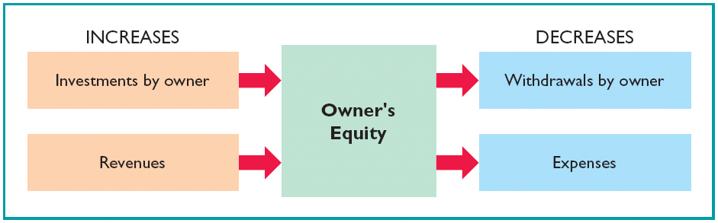
Owners’ Equity
Illustration 1-6
Revenues result from business activities entered into for the purpose of earning income.
Common sources of revenue are: sales, fees, services, commissions, interest, dividends, royalties, and rent.
LO 6 State the accounting equation, and define assets, liabilities, and owner’s equity.

Slide 28
Owners’ Equity
Illustration 1-6
Expenses are the cost of assets consumed or services used in the process of earning revenue.
Common expenses are: salaries expense, rent expense, utilities expense, tax expense, etc.
LO 6 State the accounting equation, and define assets, liabilities, and owner’s equity.

Slide 29
Using The Basic Accounting Equation
Transactions are a business’s economic events recorded by accountants.
  May be external or internal.
  Not all activities represent transactions.
  Each transaction has a dual effect on the accounting equation.
LO 7 Analyze the effects of business transactions on the accounting equation.

Slide 30


Transactions (Question?)
Q1-15: Are the following events recorded in the accounting records?
Owner withdraws cash for personal use.
Supplies are purchased on account.
An employee is hired.
Event
Criterion
Is the financial position (assets, liabilities, or owner’s equity) of the company changed?
Record/ Don’t Record
LO 7 Analyze the effects of business transactions on the accounting equation.

Slide 31
Transactions
Discussion Question
Q18. In February 2008, Paula King invested an additional $10,000 in her business, King’s Pharmacy, which is organized as a proprietorship. King’s accountant, Lance Jones, recorded this receipt as an increase in cash and revenues. Is this treatment appropriate? Why or why not?
See notes page for discussion
LO 7 Analyze the effects of business transactions on the accounting equation.
Notes:
Question 18 (Chapter 1) No, this treatment is not proper. While the transactions does involve a receipt of cash, it does not represent revenues. Revenues are the gross increase in owner’s equity resulting from business activities entered into for the purpose of earning income. This transactions is simply an additional investment made by the owner in the business.

Slide 32
Transactions (Problem)
P1-1A: Barone’s Repair Shop was started on May 1 by Nancy. Prepare a tabular analysis of the following transactions for the month of May.
1. Invested $10,000 cash to start the repair shop.
Assets
Liabilities
Equity
Accounts Receivable
Accounts Payable
Barone, Capital
Cash
+
+
Equipment
=
+
1.
+10,000
+10,000
Investment
LO 7 Analyze the effects of business transactions on the accounting equation.

Slide 33
Transactions (Problem)
2. Purchased equipment for $5,000 cash.
Assets
Liabilities
Equity
Accounts Receivable
Accounts Payable
Barone, Capital
Cash
+
+
Equipment
=
+
1.
+10,000
+10,000
Investment
2.
-5,000
+5,000
LO 7 Analyze the effects of business transactions on the accounting equation.

Slide 34
Transactions (Problem)
3. Paid $400 cash for May office rent.
Assets
Liabilities
Equity
Accounts Receivable
Accounts Payable
Barone, Capital
Cash
+
+
Equipment
=
+
1.
+10,000
+10,000
Investment
2.
-5,000
+5,000
3.
-400
-400
Expense
LO 7 Analyze the effects of business transactions on the accounting equation.

Slide 35
Transactions (Problem)
4. Received $5,100 from customers for repair service.
Assets
Liabilities
Equity
Accounts Receivable
Accounts Payable
Barone, Capital
Cash
+
+
Equipment
=
+
1.
+10,000
+10,000
Investment
2.
-5,000
+5,000
3.
-400
-400
Expense
4.
+5,100
+5,100
Revenue
LO 7 Analyze the effects of business transactions on the accounting equation.

Slide 36
Transactions (Problem)
5. Withdrew $1,000 cash for personal use.
Assets
Liabilities
Equity
Accounts Receivable
Accounts Payable
Barone, Capital
Cash
+
+
Equipment
=
+
1.
+10,000
+10,000
Investment
2.
-5,000
+5,000
3.
-400
-400
Expense
4.
+5,100
+5,100
Revenue
5.
-1,000
-1,000
Drawings
LO 7 Analyze the effects of business transactions on the accounting equation.

Slide 37
Transactions (Problem)
6. Paid part-time employee salaries of $2,000.
Assets
Liabilities
Equity
Accounts Receivable
Accounts Payable
Barone, Capital
Cash
+
+
Equipment
=
+
1.
+10,000
+10,000
Investment
2.
-5,000
+5,000
3.
-400
-400
Expense
4.
+5,100
+5,100
Revenue
5.
-1,000
-1,000
Drawings
6.
-2,000
-2,000
Expense
LO 7 Analyze the effects of business transactions on the accounting equation.

Slide 38
Transactions (Problem)
7. Incurred $250 of advertising costs, on account.
Assets
Liabilities
Equity
Accounts Receivable
Accounts Payable
Barone, Capital
Cash
+
+
Equipment
=
+
1.
+10,000
+10,000
Investment
2.
-5,000
+5,000
3.
-400
-400
Expense
4.
+5,100
+5,100
Revenue
5.
-1,000
-1,000
Drawings
6.
-2,000
-2,000
Expense
7.
+250
-250
Expense
LO 7 Analyze the effects of business transactions on the accounting equation.

Slide 39
Transactions (Problem)
8. Provided $750 of repair services on account.
Assets
Liabilities
Equity
Accounts Receivable
Accounts Payable
Barone, Capital
Cash
+
+
Equipment
=
+
1.
+10,000
+10,000
Investment
2.
-5,000
+5,000
3.
-400
-400
Expense
4.
+5,100
+5,100
Revenue
5.
-1,000
-1,000
Drawings
6.
-2,000
-2,000
Expense
7.
+250
-250
Expense
8.
+750
+750
Revenue
LO 7 Analyze the effects of business transactions on the accounting equation.

Slide 40
Transactions (Problem)
9. Collected $120 cash for services previously billed.
Assets
Liabilities
Equity
Accounts Receivable
Accounts Payable
Barone, Capital
Cash
+
+
Equipment
=
+
1.
+10,000
+10,000
Investment
2.
-5,000
+5,000
3.
-400
-400
Expense
4.
+5,100
+5,100
Revenue
5.
-1,000
-1,000
Drawings
6.
-2,000
-2,000
Expense
7.
+250
-250
Expense
8.
+750
+750
Revenue
9.
+120
-120
6,820 + 630 + 5,000 = 250 + 12,200
LO 7 Analyze the effects of business transactions on the accounting equation.

Slide 41
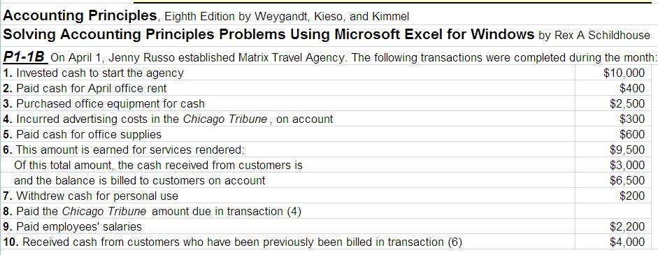

Slide 42
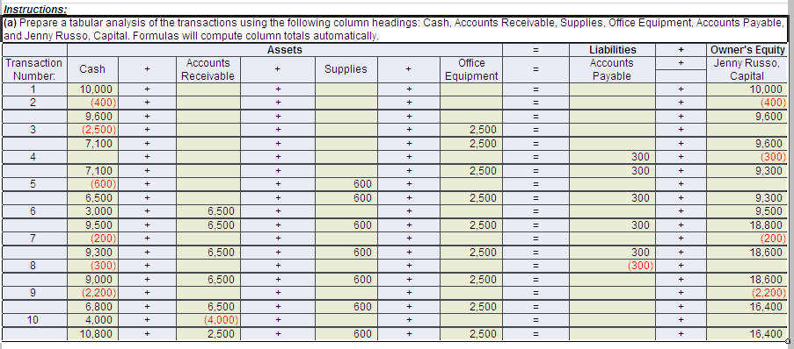

Slide 43
Problem
P1-2B cindy Belton opened a law office, Cindy Belton Attorney at law, on July 1, 2008. On July 31, the balance sheet showed cash $4000, Accounts Receivable $1500, Supplies $500, office equipment $5000, accounts payable $4200 and Cindy Belton capital $6800. During August the following transaction occurred:
Collected $1400 of accounts receivables
Paid $2700 cash on accounts payables
Earned revenue of $9000, of which $3000 is collected in cash and the balance is due on September
Purchased additional office equipment for $1000, paying $400 in cash and the balance on account
Paid salaries $3000, rent for July $900, and advertising expense $350
Withdrew $750 cash on personal use
Received $2000 from Standard Federal Bank- money borrowed on a note payable
Incurred utility expense for month on account $250
Instructions:
Prepare a tabular analysis of the August transactions beginning with July 31 balances. The column heading should be as follows: cash+ accounts receivable+ supplies+ office equipment= note payable+ accounts payable+ Cindy Belton, capital.

Slide 44
Financial Statements
Companies prepare four financial statements from the summarized accounting data:
Income Statement
Owner’s Equity Statement
Balance Sheet
Statement of Cash Flows
LO 8 Understand the four financial statements and how they are prepared.

Slide 45
Financial Statements
Review Question
Net income will result during a time period when:
  assets exceed liabilities.
  assets exceed revenues.
  expenses exceed revenues.
  revenues exceed expenses.
LO 8 Understand the four financial statements and how they are prepared.

Slide 46
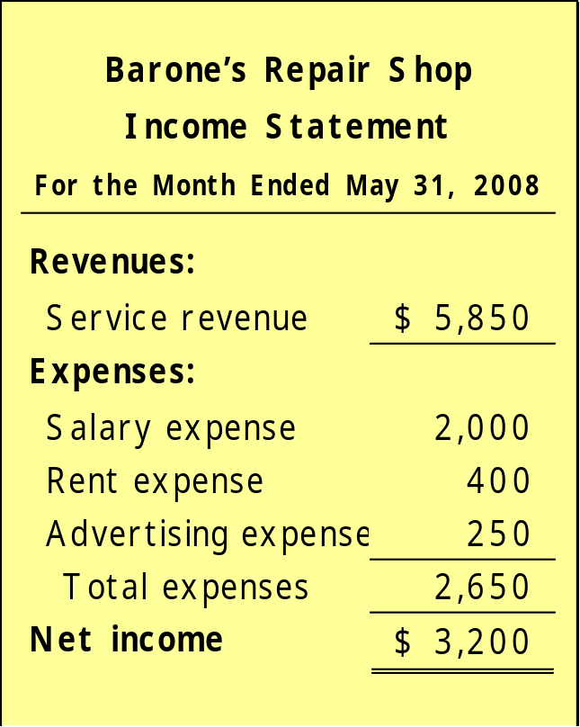
Financial Statements
Income Statement
Reports the revenues and expenses for a specific period of time.
Net income – revenues exceed expenses.
Net loss – expenses exceed revenues.
LO 8 Understand the four financial statements and how they are prepared.

Slide 47
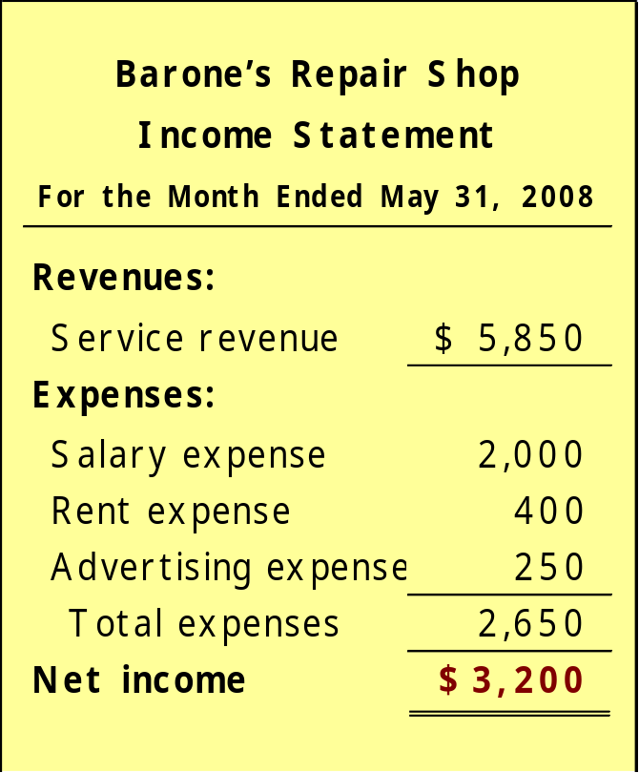
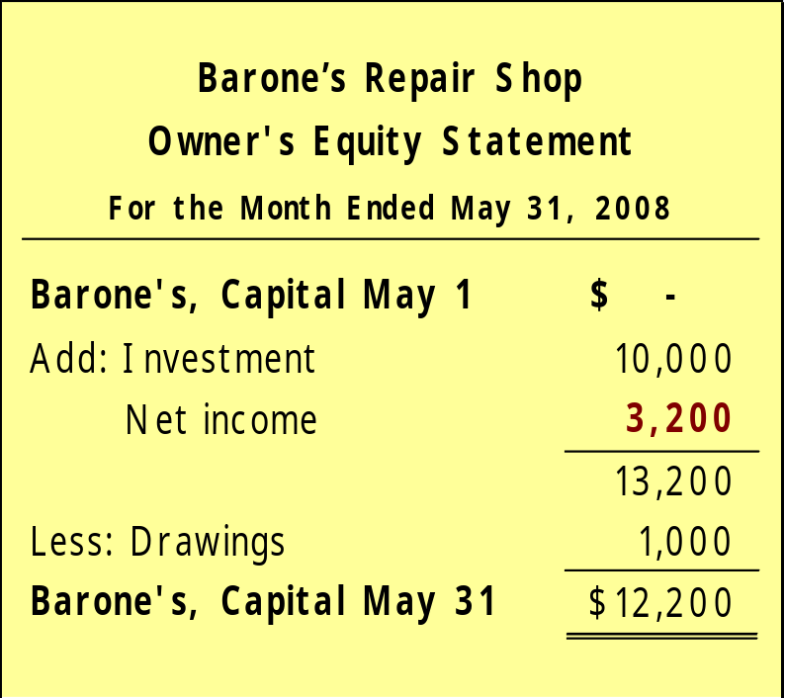
Financial Statements
Owner’s Equity Statement
Income Statement
Net income is needed to determine the ending balance in owner’s equity.
LO 8 Understand the four financial statements and how they are prepared.

Slide 48
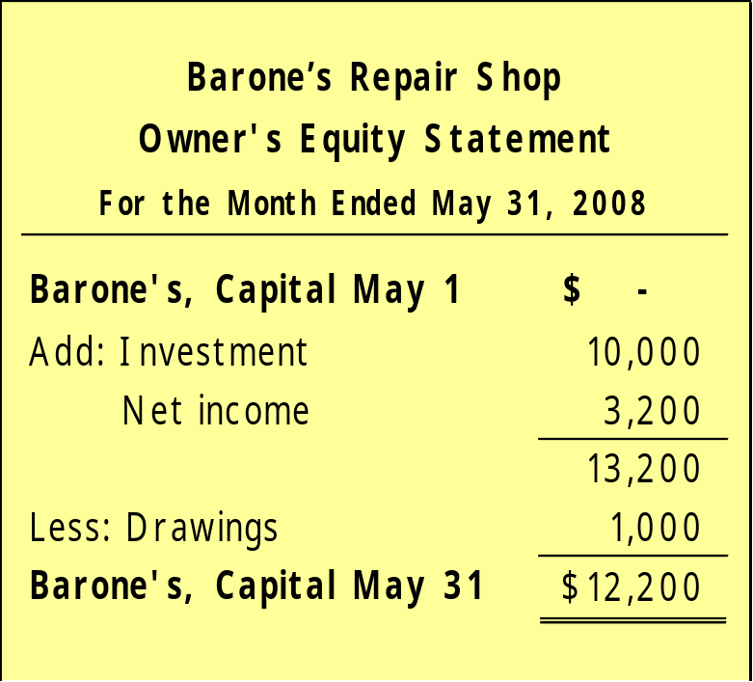
Financial Statements
Owner’s Equity Statement
Statement indicates the reasons why owner’s equity has increased or decreased during the period.
LO 8 Understand the four financial statements and how they are prepared.

Slide 49
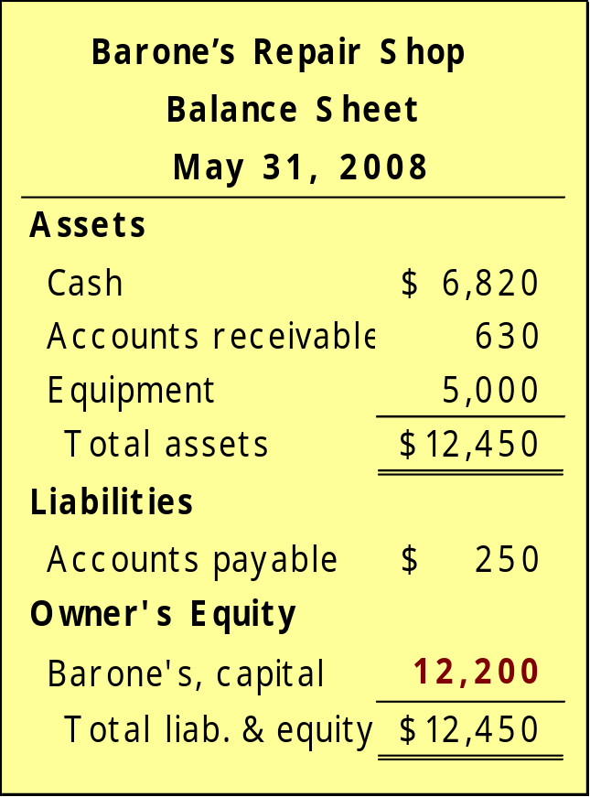
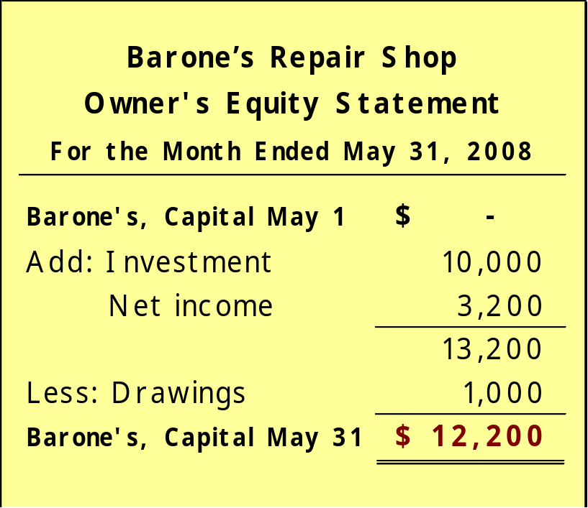
Financial Statements
Owners’ Equity Statement
Balance Sheet
The ending balance in owner’s equity is needed in preparing the balance sheet
LO 8 Understand the four financial statements and how they are prepared.

Slide 50
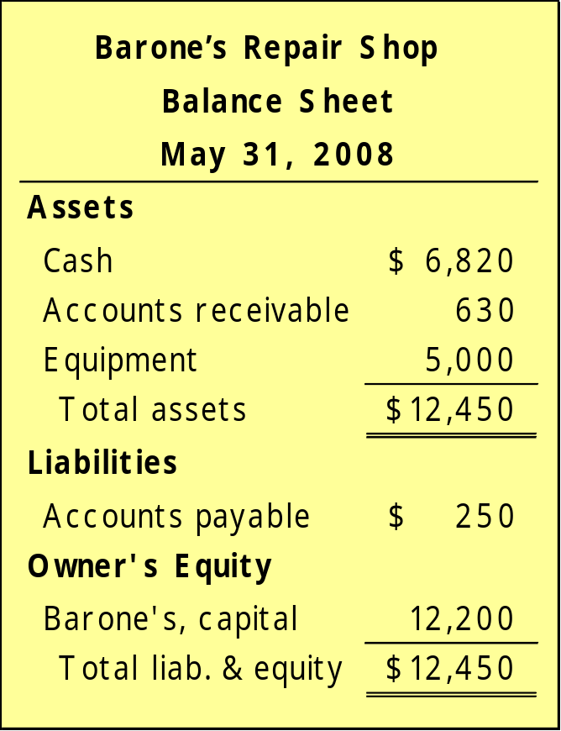
Financial Statements
Balance Sheet
Reports the assets, liabilities, and owner’s equity at a specific date.
Assets listed at the top, followed by liabilities and owner’s equity.
Total assets must equal total liabilities and owner’s equity.
LO 8 Understand the four financial statements and how they are prepared.

Slide 51
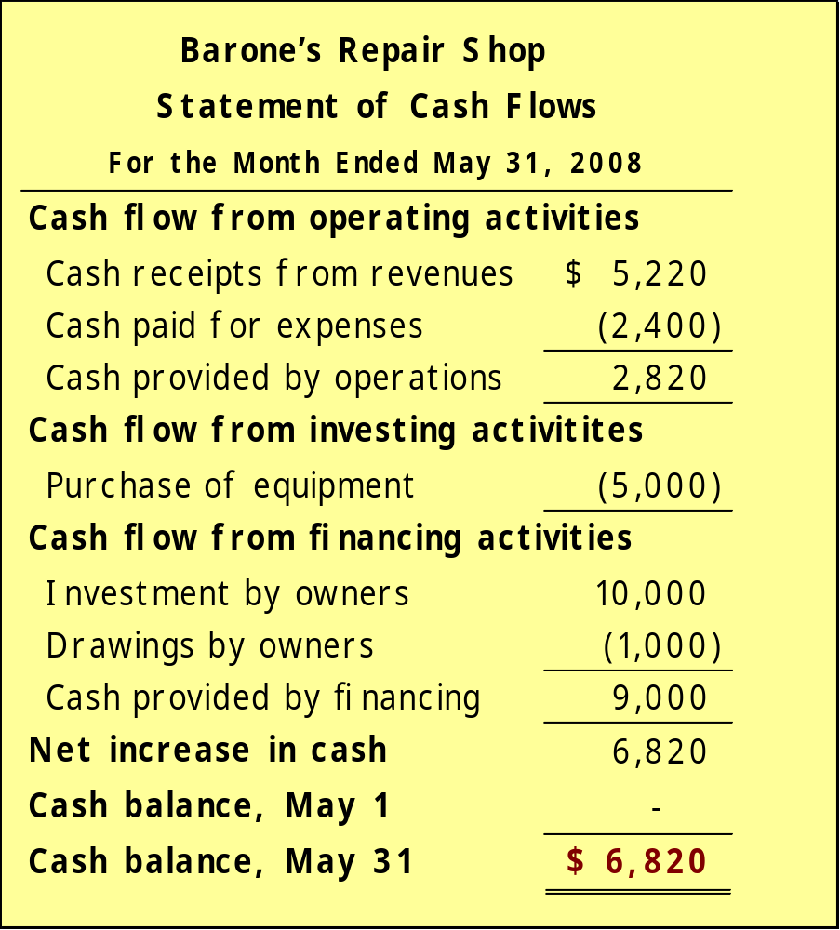
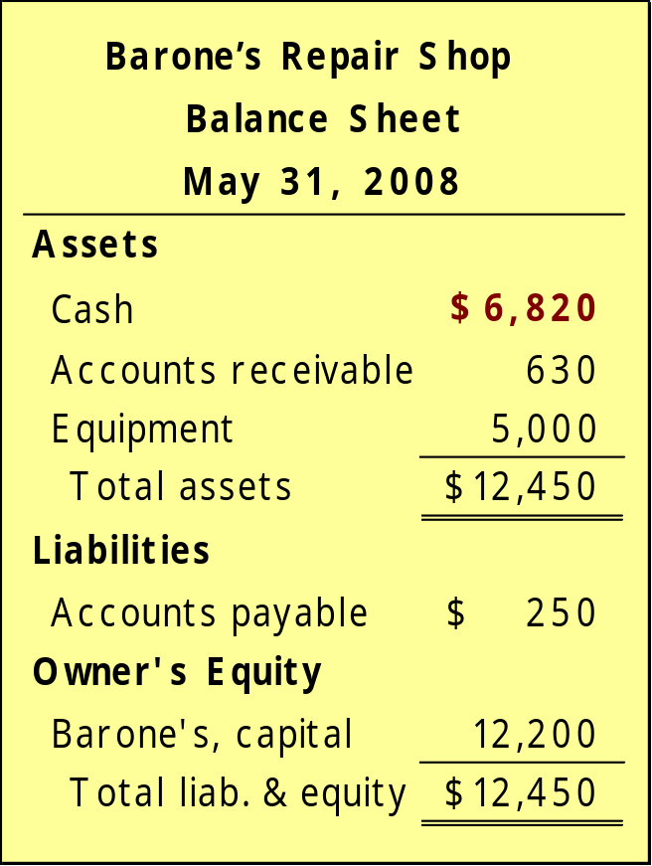
Financial Statements
Statement of Cash Flows
Balance Sheet
LO 8 Understand the four financial statements and how they are prepared.

Slide 52
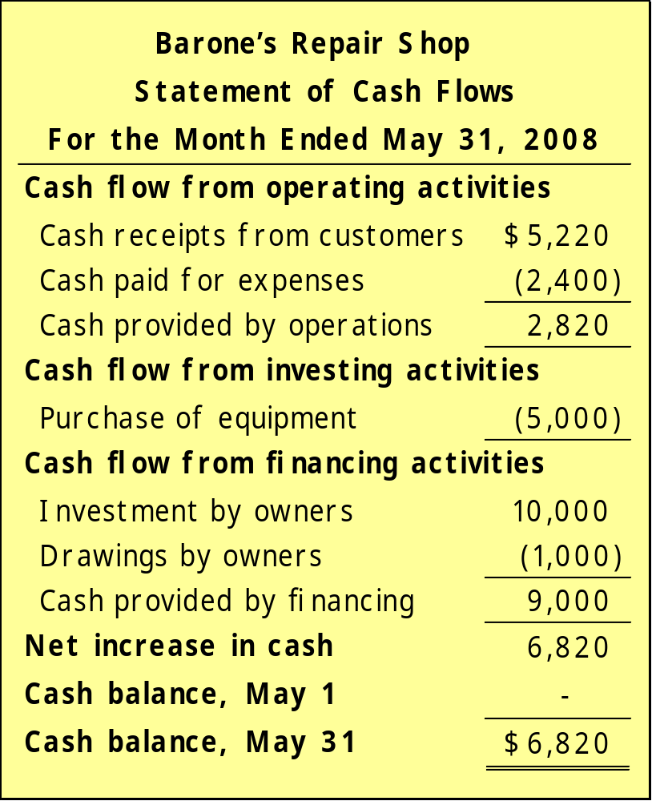
Financial Statements
Statement of Cash Flows
Information for a specific period of time.
Answers the following:
Where did cash come from?
What was cash used for?
What was the change in the cash balance?
LO 8 Understand the four financial statements and how they are prepared.

Slide 53
Financial Statements
Review Question
Which of the following financial statements is prepared as of a specific date?
  Balance sheet.
  Income statement.
  Owner's equity statement.
  Statement of cash flows.
LO 8 Understand the four financial statements and how they are prepared.

Slide 54
Financial Statements
Discussion Question
Q19. “A company’s net income appears directly on the income statement and the owner’s equity statement, and it is included indirectly in the company’s balance sheet.” Do you agree? Explain.
See notes page for discussion
LO 8 Understand the four financial statements and how they are prepared.
Notes:
Question 19 (textbook) Y e s . Net income does appear on the income statement — it is the result of subtracting expenses from revenues. In addition, net income appears in the statement of owner’s equity—it is shown as an addition to the beginning-of-period capital. Indirectly, the net income of a company is also included in the balance sheet. It is included in the capital account which appears in the owner’s equity section of the balance sheet.

